Slide 1
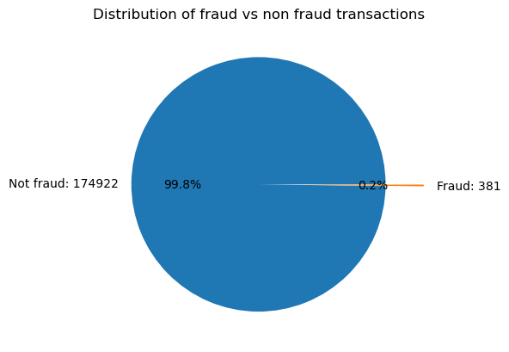
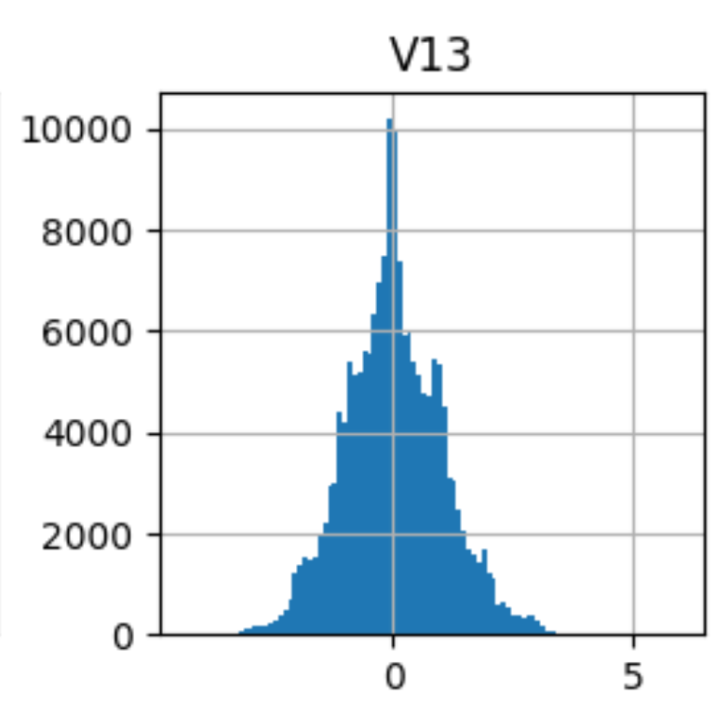
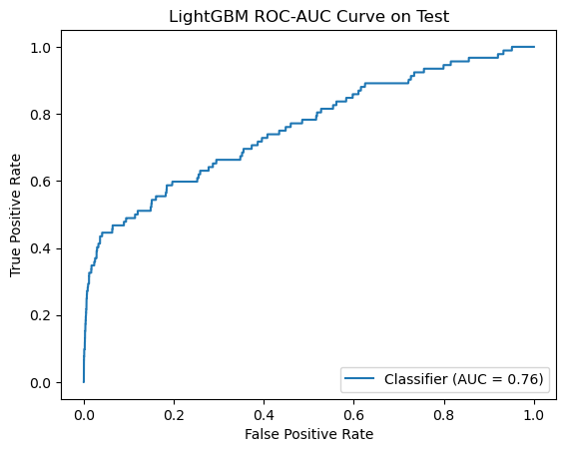
Credit Card Fraud Detection – MJE
Enoch Shumway, Jack Agren, Matthew Backlund
Introduction
Data Analysis
The data we chose for our project is the Credit Card Fraud Detection dataset. Fraud detection is an important security measure for financial organizations such as banks and credit card companies. The data provided is not real-world data but was generated from a deep-learning model.
From the data we trained and tested multiple models in an attempt to use Machine Learning to detect fraudulent transactions
There are several key characteristics of this data that need to be pointed out:
Imbalance - As shown in the pie chart, this data set is extremely imbalanced. This had a big impact on the number of viable models for this data set.
Obfuscated feature names - The names of the features were removed for privacy purposes, making feature engineering more difficult.
Preprocessed data - The actual values in the data were previously transformed. However, it appeared each feature was scaled differently.
Results
Model Designs
Our best performing model was the LGBM model, giving use a score of 0.76 for ROC AUC. We used Optuna to optimize hyperparameters utilizing ROC AUC for tuning.
The default probability threshold of 0.5 performs badly, however adjusting the threshold would be a choice made by the users of this model depending on their use case as this greatly impacts precision and recall scores.
Here are our attempted models and their best ROC AUC scores. ROC scores were used on the Kaggle competition.
In a real-world scenario, there would be a fundamental tradeoff between Precision and Recall due to the imbalanced nature of this data set. This is why we are using ROC AUC scores.
Preprocessing
Model | Score
Dummy classifier | ROC: 0.5
K-NN | ROC: 0.5
Logistic Regression | ROC: 0.56
Descision Tree | ROC: 0.54
Isolation Forest | Precision: 0.02 Recall: 0.38 F1: 0.04
LGBM Classifier | ROC: 0.76
Adaboost | ROC: 0.75
Due to the nature of our data, our preprocessing was limited:
The ‘id’ and ‘time’ features were dropped as they were either irrelevant or non-impactful on model performance.
Standard Scaler was used on all other features. Standard Scaler was used because the features seemed to be scaled differently.
Oversampling was used to overrepresent the positive class.

